Slide 1
Assay Overview
dicty cells
grayness = folate
0
minutes
~30 minutes
~90 minutes
Notes:
These slides are a combination of those of Jon Moore (Pomona College) who is posting them and Melissa Petreaca (Pomona College, DePauw University, Ohio State University).

Slide 2
3 Videos
THIS IS JUST A STAND-IN FOR THE THREE VIDEOS I WILL SHOW TO DISCUSS
DICTY MOTILITY AND THE DICTY LIFE CYCLE.

Slide 3
Quick
exposure
to cell
motility
Microtubules
HERE WOULD BE A FIGURE ON MICROTUBULE POLYMERIZATION AND DE-POLYMERIZATION.
AGAIN, I HAVE LEFT THEM OUT OF THIS PUBLICLY AVAILABLE PPT BECAUSE THEY ARE
COPYRIGHTED FROM A TEXT BOOK, BUT COULD BE USED IN CLASS UNDER FAIR-USE PROVISIONS.
ALL THESE TOPICS WILL BE DISCUSSED IN CLASS MORE FULLY, SO THIS OVERVIEW IS REALLY
SUPERFICIAL.
Notes:
The basic subunits for microtubules consist of tubulin dimers, while the basic subunits for microfilaments are actin monomers. Microtubules are much larger than microfilaments, consisting of a tube of 13 protofilaments, each made of dimer subunits. Microfilaments are small, and consist only of two protofilaments that consist of monomer subunits. In microtubules, the subunits are bound to GTP and have GTPase activity, while in microfilaments, the subunits bind to ATP and have ATPase activity. Both microtubules and microfilaments are asymmetric, having a plus end and a minus end. The process of disassembly in microfilaments is much slower than the process of depolymerization, or “catastrophe”, in microtubules. While disassembly/cleavage of microfilaments promotes treadmilling, the filaments are unlikely to rapidly disassemble completely, in contrast to microtubules, which depolymerize rapidly and completely.

Slide 4
Actin and microfilament structure
Quick
exposure
to cell
motility
F-actin: actin filament
FIGURES ON ACTIN ITSELF WITHOUT YET GOING
HEAVILY INTO MICROFILIMENTS.
G-actin: actin monomer
Bound to ATP
Top: Pearson Education
Bottom: http://biomachina.org/research/projects/actin/lorenz.gif
Notes:
http://biomachina.org/research/projects/actin/lorenz.gif
Microfilaments are the smallest of the cytoskeletal filaments
They are best known for their role in muscle contraction
They play a role in cell migration, amoeboid movement, and cytoplasmic streaming
Development and maintenance of cell shape (via microfilaments just beneath the plasma membrane at the cell cortex)
Structural core of microvilli
Actin is a very abundant protein in all eukaryotic cells
Once synthesized, it folds into a globular-shaped molecule that can bind ATP or ADP (G-actin; globular actin)
G-actin molecules polymerize to form microfilaments, F-actin
K_{ON} :The rate of subunit addition is proportional to the concentration of free subunits.
K_{OFF} : the rate of subunit loss is independent of the concentration of free subunits.

Slide 5
Microfilament (actin) polymerization
Quick
exposure
to cell
motility
FIGURES ON MICROFILIMENT ASSEMBLY AND DISASSYMBLY.
“Barbed” end
“Pointed” end
“Barbed” end
“Pointed” end
Modified from Nürnberg et. al (2011). Nat Rev Cancer, 11:177-187 and Molecular Biology of the Cell, 5th edition.
Notes:
Microfilaments are the smallest of the cytoskeletal filaments
They are best known for their role in muscle contraction
They play a role in cell migration, amoeboid movement, and cytoplasmic streaming
Development and maintenance of cell shape (via microfilaments just beneath the plasma membrane at the cell cortex)
Structural core of microvilli
Actin is a very abundant protein in all eukaryotic cells
Once synthesized, it folds into a globular-shaped molecule that can bind ATP or ADP (G-actin; globular actin)
G-actin molecules polymerize to form microfilaments, F-actin
K_{ON} :The rate of subunit addition is proportional to the concentration of free subunits.
K_{OFF} : the rate of subunit loss is independent of the concentration of free subunits.

Slide 6
Quick
exposure
to cell
motility
Arp 2/3 complex nucleates assembly
FIGURES ON ARP2/3 AND THE BRANCHING OF ACTION
Modified from Nürnberg et. al (2011). Nat Rev Cancer, 11:177-187 and Molecular Biology of the Cell, 5th edition.
Mullins et. al (1998). Proc. Natl. Acad. Sci. USA, 95:6181–6186.
Notes:
Arp2/3 and formins can nucleate microfilament assembly
Filaments induced by Arp2/3 vs. formins have different structures
Arp 2/3
Caps the minus (pointed) end
Nucleate actin filament assembly along the sides of pre-existing filaments to form an actin meshwork
Promotes the formation of lamellipodia

Slide 7
Quick
exposure
to cell
motility
Actin-associated signaling in migration
PIP₃
FIGURES ON BRANCHED ACTIN PUSHING THE
CELL MEMBRANE.
Pollard (2003). Nature, 422:741-745.
Notes:
Figure 1 The dendritic-nucleation model for protrusion of lamellipodia.
External cues (step 1) activate signalling pathways that lead to GTPases (2). These then activate Wiskott–Aldrich syndrome protein (WASP) and related proteins (3), which in turn activate Arp2/3 complex. Arp2/3 complex initiates a new filament as a branch on the side of an existing filament (4). Each new filament grows rapidly (5), fed by a high concentration of profilin-bound actin stored in the cytoplasm, and this pushes the plasma membrane forward (6). Capping protein binds to the growing ends, terminating elongation (7). Actin-depolymerizing factor (ADF)/cofilin then severs and depolymerizes the ADP filaments, mainly in the ‘older regions of the
filaments (8, 9). Profilin re-enters the cycle at this point, promoting dissociation of ADP and binding of ATP to dissociated subunits (10). ATP–actin binds to profilin, refilling the pool of subunits available for assembly (11).

Slide 8
Quick
exposure
to cell
motility
Actin-based structures in migrating cells
FIGURES ON DIFFERENT SORTS OF ACTIN BASED STRUCTURES.
Blanchoin et. al (2014). Physiol Rev, 94:235–263.
Notes:
Schematic representation of the cell with the different architectures indicated: i) the cell cortex; ii) an example of a contractile fiber, the stress fiber; iii) the lamellpodium; and iv) filopodia. The zoom regions highlight
architectural specificities of different regions of the cell.

Slide 9
Quick
exposure
to cell
motility
Focal adhesions are needed for cell migration
FIGURES ON FOCAL ADHESIONS AND THE PROCESS: EXTENSION/PROTRUSION, ABHESION, TRANSLOCATION, & DE-ADHESION.
http://www.mechanobio.info/figure/1384242961310.jpg.html#
Notes:
1. Polymerization of actin filaments at the leading edge is translated into protrusive force. 2. Membrane protrusion facilitates the binding of transmembrane cell surface receptors to the substratum components. New adhesions are rapidly linked to the network of actin filaments. 3. The combined activity of retrograde actin movement and contractile forces produced by stress fibers generate tension to pull the cell body forward. 4. The forces produced by the contractile network combined with actin filament and focal adhesion disassembly, helps to retract the trailing cell edge. (Note: the "space" between the cell and the substrate [shown as a gray bar] is exaggerated in this diagram).
Mechanobiology Institute, National University of Singapore, Republic of Singapore. Illustrator: Chun Xi Wong
http://mcdb3280colorado.pbworks.com/w/page/15225500/Actin

Slide 10
Quick
exposure
to cell
motility
RTK → PI3K, Rac → WAVE → Arp2/3
Non-migrating cell
FIGURES ON SIGNAL TRANSDUCTION.
Migrating cell
Modified from Essential Cell Biology (© Garland Science 2010)

Slide 11
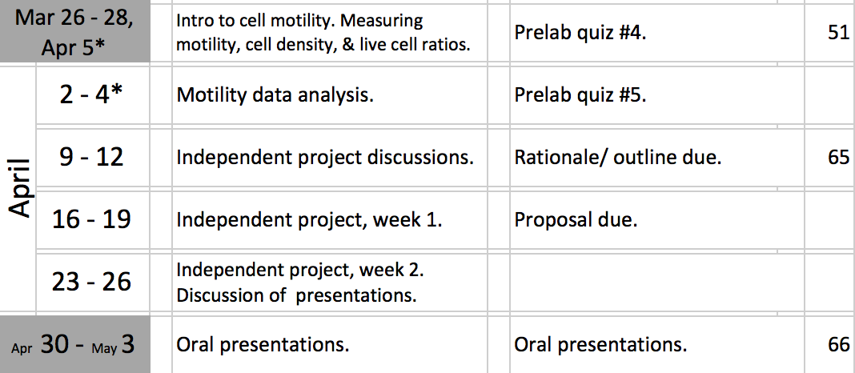
Project Overview
THIS SLIDE COMBINES THE FIRST TWO LABS INTO ONE..

Slide 13
More magnification is not always better
Notes:
WHAT IS THIS A PICTURE?

Slide 14
Brighter is not always better

Slide 15
There is too dark, too.

Slide 16
Happy medium.

Slide 17
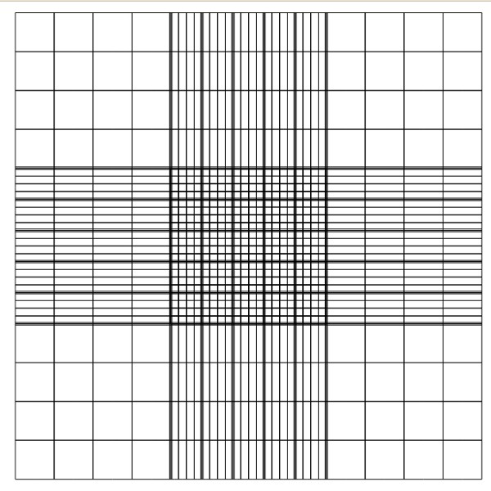
On a hemocytometer, what is a “1-mm² field”?
3 mm
1 mm
1 mm
3 mm

