Slide 1
A quick guide to the T-test
An outline of the general problem:
-We’ve got two samples of related
data. Almost never are the two
samples identical, even if they are
from experiments that are as identical
as we can make them.
-We want to know if they are
different enough to think of them as
coming not from effectively identical
experiments.
Notes:
These slides are the product of Jon Moore (Pomona College).
What you think? Could these two data sets be different samples from the same experiment?
(Much of this could be made different degrees of active depending on the likes of the instructor.)

Slide 2
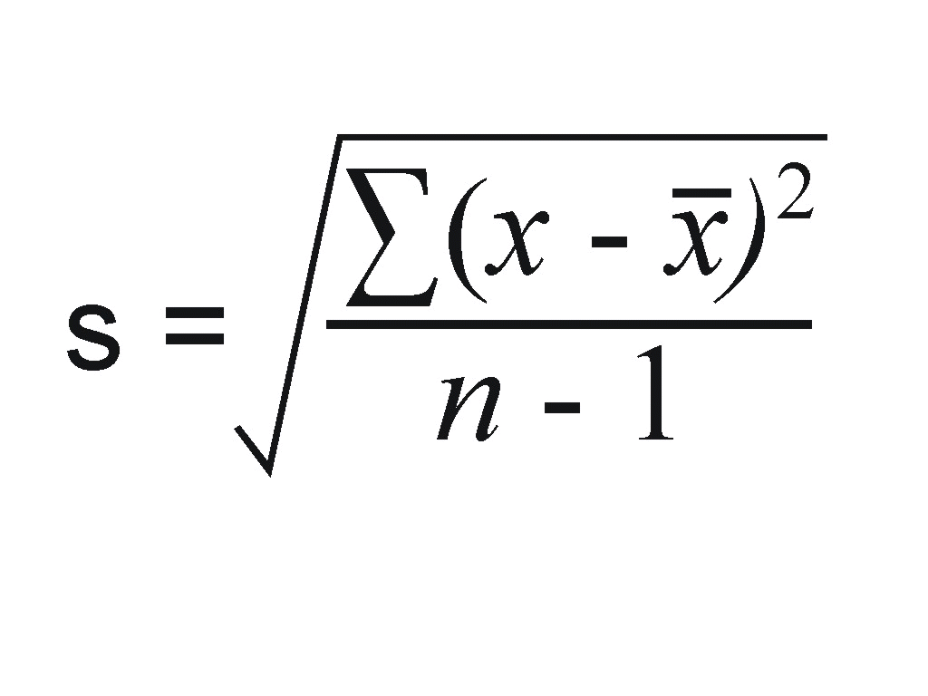
Terms and background
Population: a big complete set of data. A sample is a small subset of a population.
Mean: a measure of the center of a set of data; the average;
Standard Deviation: a measure of how much a set of data vary from
the mean. The variance is the square of the standard deviation.
Normal Distribution: A certain bell shaped curve. When many small sources of variability are added together, the total variability tends to assume a normal distribution.
and σ are conventionally used in stats for the
mean and standard deviation of a population,
respectively, while x-bar and s are used more generally.
+1 st. dev., σ
mean, μ
value

Slide 3
6 Steps of any Statistical Hypothesis Testing
(1) Choose a significance level, α. Often this is 5%.
(2) Formulate a null hypothesis (expressed as an equality) and an alternative hypothesis. The alternate hypothesis can be either an one-sided (e.g., x > y) or two-sided (e.g., x ≠ y).
(3) Choose a test statistic. This discussion centers on the t-statistic.
(4) Compute the test statistic.
(5) Compute a P-value and compare this to α.
(6) Draw a conclusion.
Notes:
This is arbitrary, but it makes the arbitrariness of decisions less subjective.
Null hypothesis is there is no difference. The alternative hypothesis is that there is a difference, sometimes in a given direction. This one is very tightly tied to your scientific hypothesis, like adding this drug will slow migration.
(2 & 3) The significance level is the fraction occasions that we’re willing to reject the null hypothesis when it is true.
(3) Other test statistics include F, chi-square, etc.
(4 & 5) In today’s example with Excel, these are almost completely combined.
(6) Tie it back to the scientific question.

Slide 4
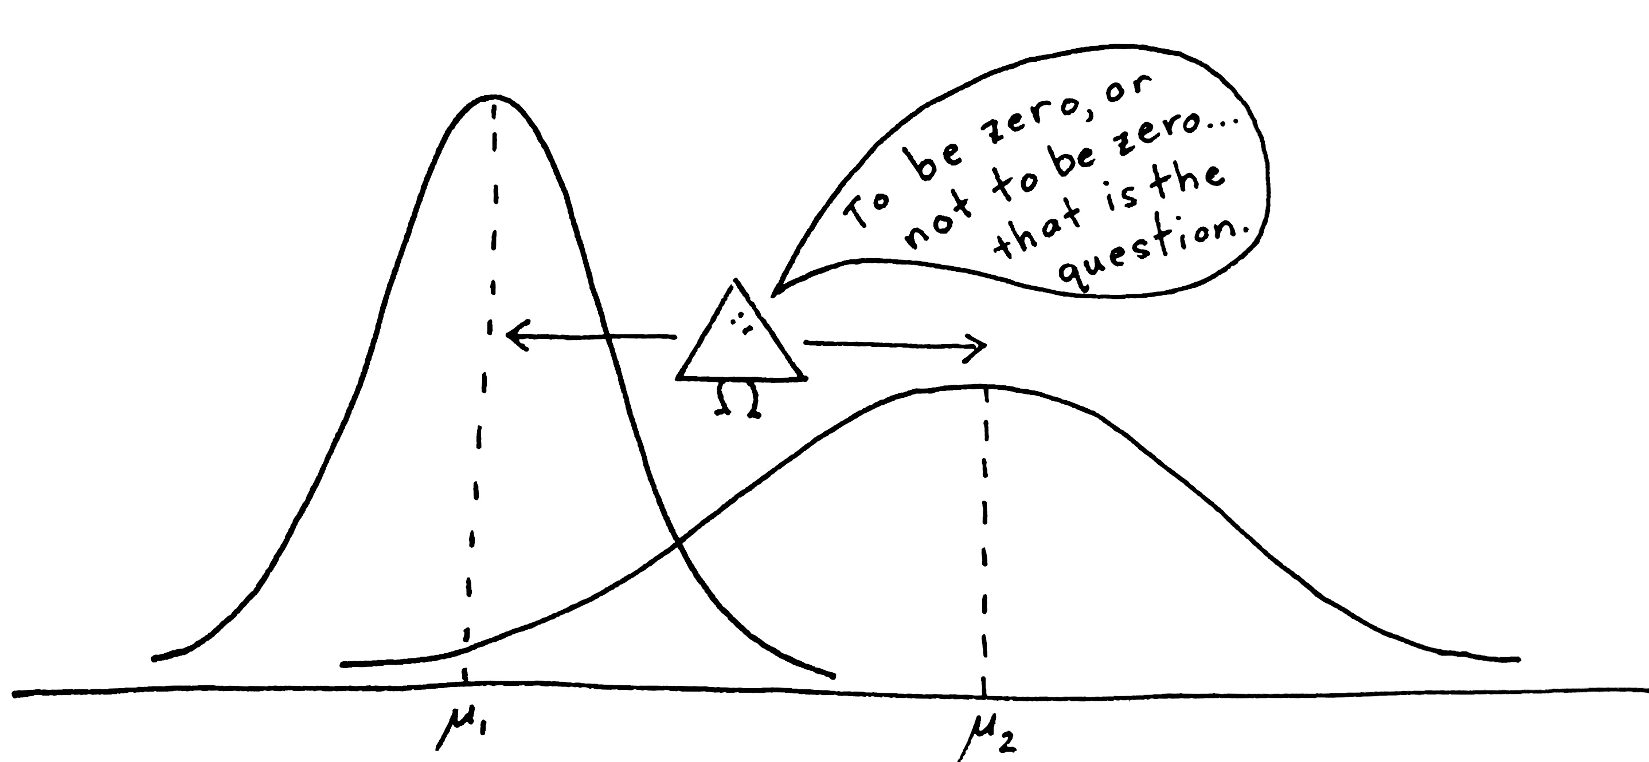
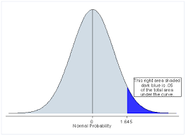
A t-test compares two samples from normally distributed populations to each other.
The null hypothesis is usually
that they are drawn from
populations with the same mean.
Our t-tests are special in 3 ways:
2 samples from populations with unequal variance
data within the sets are unpaired
Paired: heights of boy & girl twins at age 14.
Unpaired: heights of girls in Claremont, CA & Clermont, NJ at age 14.
One-sided, usually. Has to do with the
your scientific hypothesis.
Notes:
T-test intro
Three special ways
- Unequal variance is like the cartoon above. The right is wider/ has a larger variance.
Paired vs unpaired
One-sided vs two-sided examples.
Adding my drug will slow my dicty: one-sided
Adding an ion will change the speed of migration.

Slide 5
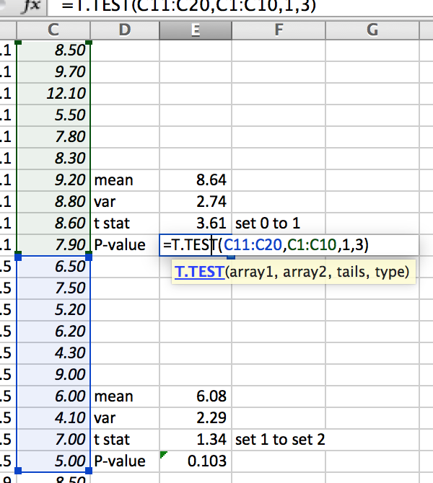
Calculating t-tests: two methods
(1) Calculate
(2) Excel. But you need to know
what you’re doing!
C11:C20 & C1:C10 are the highlighted data
ranges.
1 is for one-tailed.
3 is for unpaired with unequal variance.
Then compare t to critical value
at 5% cutoff and with (N₁ + N₂ – 2)
degrees of freedom in table.
d.f.= 18
t P-value
0.688 0.25
1.330 0.10
1.734 0.05
2.552 0.01
This yields a P-value.
If <0.05, then statistically deemed “different.”
If >0.05, then cannot say different.
Notes:
Could be nice for later to roughly plot on the board the relationship between t-statistic and the P-value.
“Different” is an air-quote-sy way of different. Hopefully when this is done, a fair number of students will get how both powerful and limited t-test p-values are.

Slide 6
One example comparing 2 samples from one population
Difference in means = 0.30 – (-0.14) = 0.44
T-test P-value= 0.21
+1 st. dev.
mean
Notes:
We’ve got a population of normally distributed data. A small sample (10) was taken, and we’ll compare that to another random sample of the same population.
What does this P-value mean?
It is greater than 0.05, so it isn’t statistically significant.
Also, it is less than 0.5, so these samples are somewhat more different than would happen half the time.
(3) For two samples chosen like the ones here, about how often would you expect to get a P-value less than 0.05?

Slide 7
Example 2 of 5
Difference in means = 0.20 – (-0.58) = 0.78
T-test P-value= 0.16
0
+1 st. dev.
mean
Notes:
- This is a different pair of random samples.
Note the difference in means is greater here (0.78) than the previous set. (0.44), but the P-value is about the same (0.16 vs 0.21) How can this be?
The standard deviations in this pair of samples are higher than the ones in the previous sample.

Slide 8
Example 3
Difference in means = 0.36 – (0.34) = 0.02
T-test P-value= 0.97
0
+1 st. dev.
mean
Notes:
This is a different pair of random samples. (We’re doing 5 pairs.)
Note how close the means are and how high the P-value is. (If the difference in the means is zero, then the P-value is one.)

Slide 9
Example 4
Difference in means = -0.28 – (-0.40) = 0.14
T-test P-value= 0.81
0
+1 st. dev.
mean
Notes:
Here’s a 4th example. Again the difference in means is modest, and the P-value is high.

Slide 10
Example 5
Difference in means = -0.30 – (0.10) = -0.40
T-test P-value= 0.52
0
+1 st. dev.
mean
Notes:
Our last pair.
The difference in the means is substantive, and one standard deviation is high, and one is low.
Our P-value is at near 0.5.

Slide 11
What drives p-values?
Difference in
P-value means Standard Deviations
0.21 0.44 0.77 0.74
0.16 0.78 1.35 1.01
0.97 0.02 0.92 1.23
0.81 0.12 1.00 1.16
0.52 -0.40 1.79 0.69
+1 st. dev.
+1 st. dev.
+1 st. dev.
+1 st. dev.
+1 st. dev.
mean
mean
mean
mean
mean
Notes:
Here is the summary.
In our five pairs of samples, none are statistically significant.
Let’s compare the first and last.
The absolute values of the difference in the means are very similar.
However, the P-values are not. Why?
(Board) When the absolute value of the t-statistic is high, the P-value is low. (On slide 5, did you plot this on the board?)
If the difference in means is high, is the P-value low or high? (point out the formula at the bottom)
If the standard deviations are high, is the P-value low or high?
So the P-value of the first pair is lower because both standard deviations are low, while one of the ones in the last pair is high.

Slide 12
Extremes
+1 st. dev.
+1 st. dev.
+1 st. dev.
+1 st. dev.
+1 st. dev.
mean
mean
mean
mean
mean
Notes:
Here is the summary again. Let’s not make more pairs. Let’s reorder these by their means.

Slide 13
Extremes
We could do this quite a while longer
Let’s see what happens when we compare
blue & yellow.
+1 st. dev.
+1 st. dev.
+1 st. dev.
+1 st. dev.
+1 st. dev.
mean
mean
mean
mean
mean
Notes:
Let’s consider what would have happened if the blue and the gold had been paired.

Slide 14
Extremes.
Difference in means = 0.30 – (-0.58) = 0.88
T-test P-value= 0.04 < 0.05
If these would have been paired random samples, then we would have rejected the null hypothesis -- the samples are from populations with the same mean.
We did reject the null hypothesis even though they are samples from the same random distribution, so of course they are from populations with the same mean.
What gives?
0
+1 st. dev.
mean

Slide 15
Could these two data sets be different samples from the same experiment?
P = 0.001
Does this say that the different conditions in the experimental design led to these differences?
D
Notes:
No. It does say that the differences were rather unlikely to have happened by chance. Also, there could be reasons not purposely included in your experiments.

Slide 16
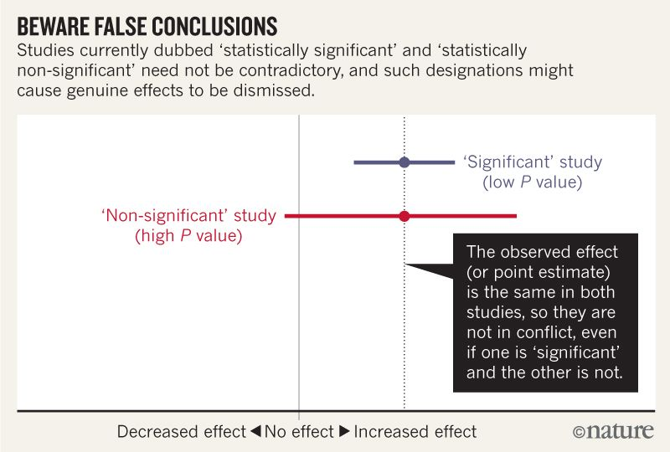
Nuance
READ:
http://www.nature.com/polopoly_fs/1.19503!/menu/main/topColumns/topLeftColumn/pdf/nature.2016.19503.pdf
WATCH:
https://www.youtube.com/watch?v=5OL1RqHrZQ8
Notes:
Want more nuance?

