Slide 1
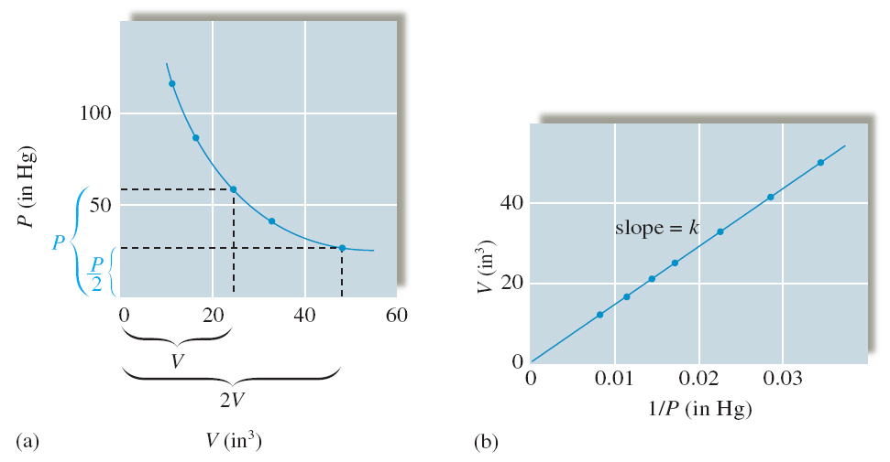
Boyle's Law
For a fixed amount of gas at constant temperature,
pressure is inversely proportional to volume.

Slide 2
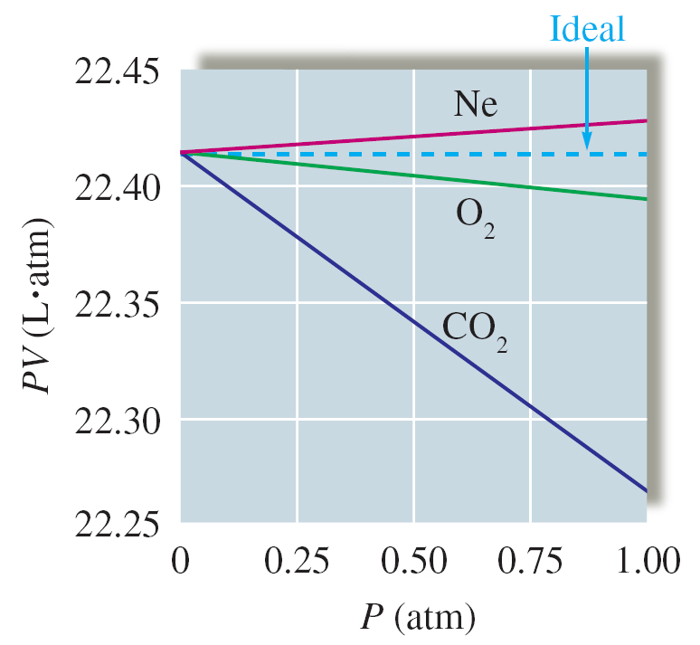
Boyle’s Law tells us that PV must be constant.

Slide 3
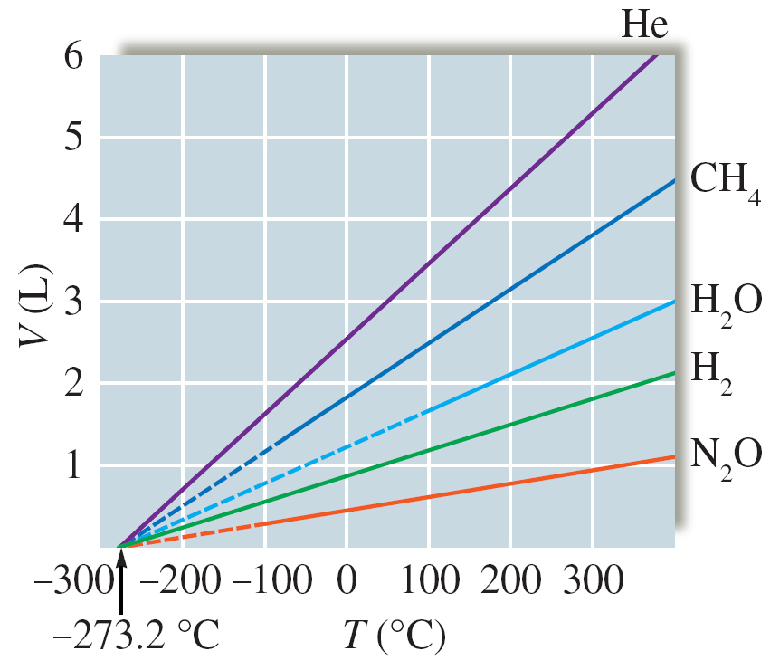
Charles’s Law
For a fixed amount of gas at constant pressure,
volume is directly proportional to temperature.

Slide 4
Ideal Gas Law
Note: Avogadro's Law: volume increases linearly with n (T, V constant)
Relation to molar mass (M):

Slide 5
Partial Pressures
Gas component 1 in the mixture has a mole fraction (x):
The partial pressure of component 1 in the mixture (P) is:

Slide 6
Expansion of an Ideal Gas
P_{ext} = 1 atm
P_{ext} = 1 atm
REMOVE PINS
Δx
pins
Irreversible Expansion
P = 1 atm
P = 2 atm
The work done is
w is negative for expansion (the gas does work on the “surroundings”)
w is positive for compression (the “surroundings” does work on the gas)

Slide 7
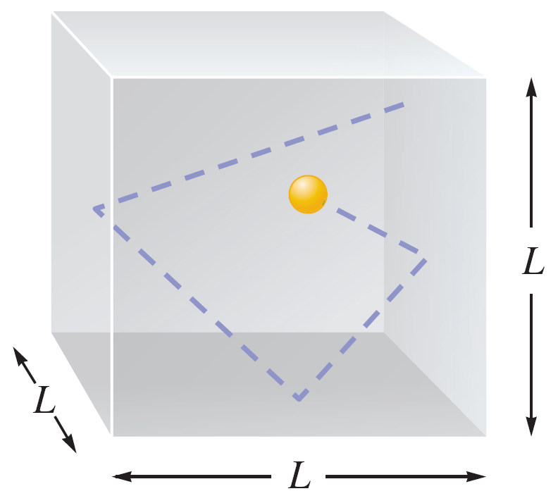
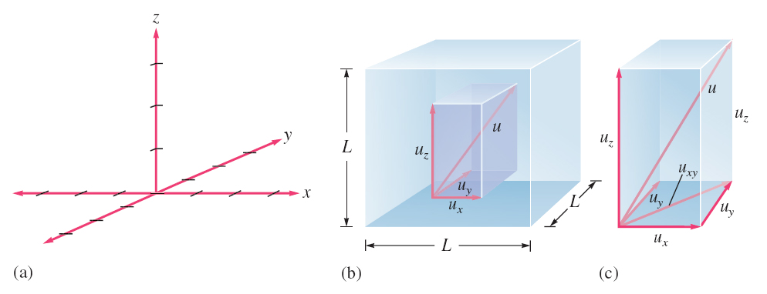
Kinetic Theory of Gases
Volume of particles assumed negligible
Pressure caused by collisions on wall
Particles in constant motion
No intermolecular interactions
Kinetic energy proportional to temperature
Collisions are are elastic
Each particle has a velocity given by:

Slide 8
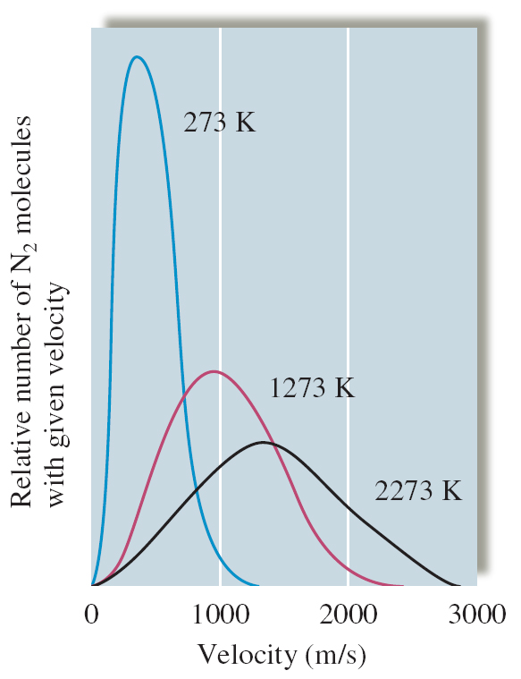
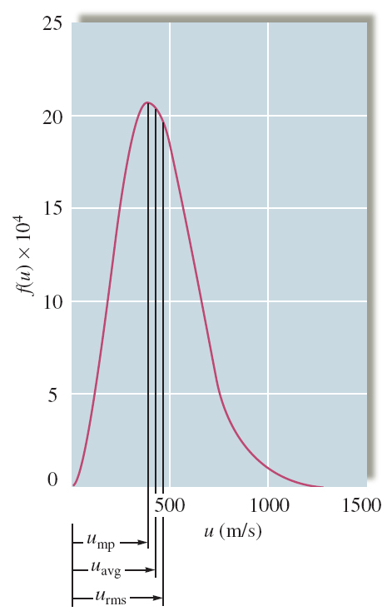
Some Important Results
For rates of effusion

Slide 9
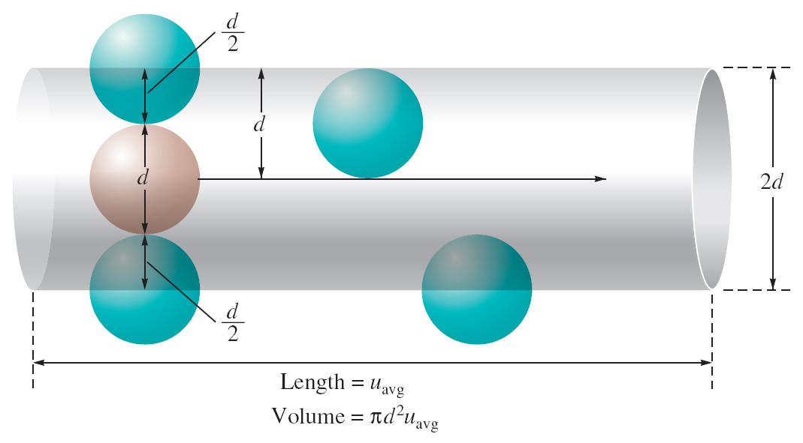
Collisions
With container walls
Intermolecular
Mean free path
(learn the proof for this one)

Slide 10
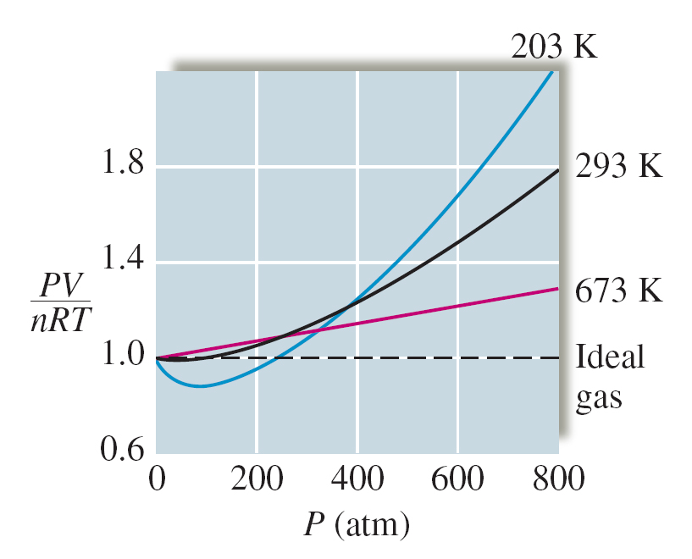
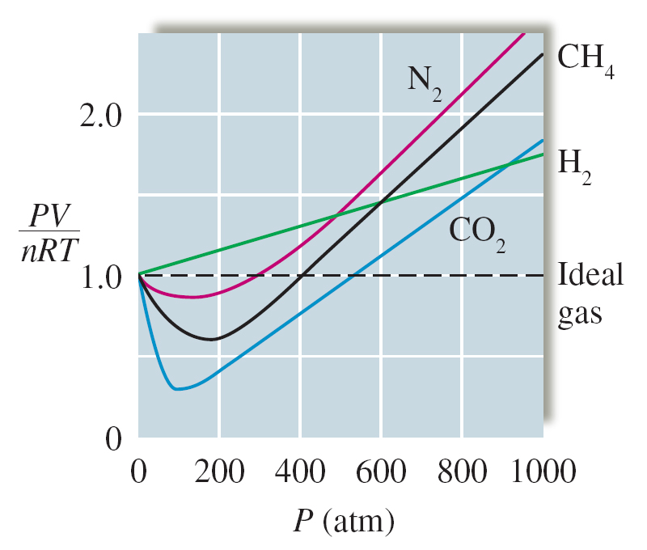
Real Gases
Molar volume is volume divided by moles, and is inversely related to density
At low P particles attract so molar volume of real gas < molar volume of ideal gas
At high P particles repel so molar volume of real gas > molar volume of ideal gas

Slide 11
Intermolecular Interactions
The Lennard-Jones Potential
Repulsion/attraction cancels out
repulsion
Potential Energy
Intermolecular separation
0
attraction
Short-range repulsion
(positive)
Long-range attraction
(negative)
Attractive interactions include dipole-dipole, dipole-induced dipole, and
London dispersion interactions
The van der Waals equation of state takes into account excluded volume due to the
finite size of particles, and a weak intermolecular attraction interaction.

Slide 12
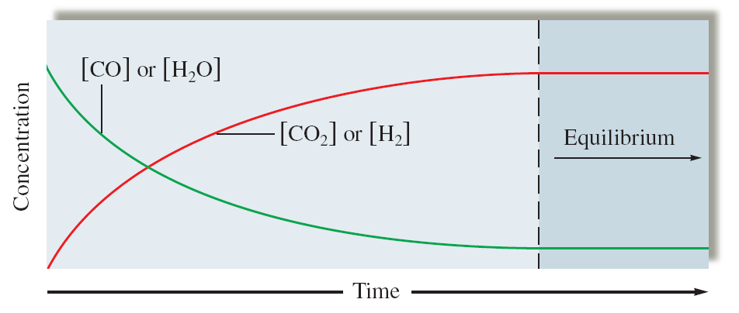
Equilibrium

Slide 13
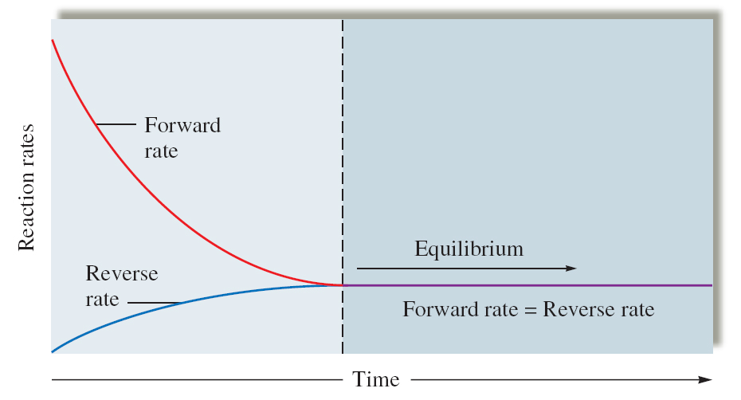

Slide 14
